Slide 1
SOLAR POWER

Slide 2
Potential for solar
A land mass of about 100x100 miles in the Southwest U.S.-less than 0.5% of the U.S. mainland land mass, or about 25% of the area currently used for the nation's highway/roadway system-could provide as much electricity as presently consumed in the United States.
Truly renewable, with a net positive energy
Can be converted into electricity

Slide 3
Solar cells
For use at site of power use
Integration of solar energy into the electrical grid
Semi-conductor
Absorb photon
Excite electron into conduction band
Mobile electron holes
directional flow of electrons
An array of solar cells produce a usable quantity of direct current (DC)
Store the charge that is produced

Slide 4
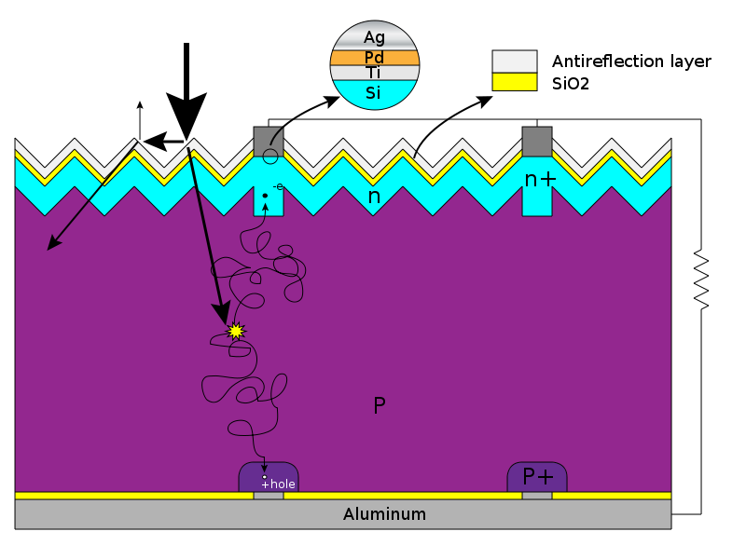
n-doped Si (electron rich) and p-doped Si (electron poor)

Slide 5
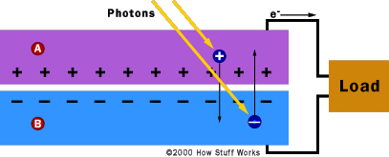

Slide 6
Types of solar cells
Wafer- based crystaline silicon
Mono vs. poly (less efficient, but cheaper)
Thin film Si – more flexible, lighter
Cadmium telluride (Cd/Te) solar cell – easier to deposit/large scale production
Cu/In/Ga
Organic polymer cells (low cost, large scale production and flexibility, poor efficiency)
Sensitized Solar cells (Grätzel cells); semi-conductor formed between photo-sensitized anode and an electrolyte

Slide 7
Performance
Efficiency (5-20 %)
Manufacturing cost (materials and methods)
Net Energy Analysis (Break even in 1-7 yrs depending on solar cell)
Trade-off between efficiency and cost

Slide 8
Additional factors
Solar concentrators (use a large area of lenses or mirrors to focus sunlight on a small area of photovoltaic cells)
400 suns
300 times reduction of materials
Inverters and grid integration
One way to two way grids that communicate

Slide 9
Table 2.1–3 Technical Barriers in Photovoltaics
Photovoltaic Technical Barriers
Modules
A. Material Utilization & Cost
B. Design & Packaging
C. Manufacturing Processes
D. Efficiency
Inverters & Other BOS
E. Inverter Reliability & Grid Integration
F. Energy Management Systems
G. BOS Cost & Installation Efficiency
Systems Engineering & Integration
H. Systems Engineering
I. Modularity & Standardization
J. Building-integrated products

Slide 10
2015 Goal
PV-produced electricity and domestic installed PV generation capacity of 5-10 GW
1000 GW/yr of electricity in US
Much more long term

Slide 11
Concentrating Solar Power (CSP) technologies
Large scale electricity plants in the Southwest US
CSP plants produce power by first converting the sun’s energy into heat, next into mechanical power, and lastly, into electricity in a conventional generator.
Thermal storage (molten salt) or hybrid natural gas system

Slide 12
Types
Trough
Dish
Tower
8-15 cents/kWhr
Goal is to get it below 5 cents/kWhr

